Slide 1
Estimated Accruals
Notes:
Introduction
Who you are
The Class
What will we do in the class

Slide 2
Estimated Accruals
Records the estimated costs of goods or services received from a vendor.
Reflects an expected accrual against a purchase order drawn from an expense-based budget (e.g. 299X, 285X, etc.)
No approval needed to be processed.
Notes:
Your requisition to purchase goods and services
Capture the approvals – Once request is approved you say what you want to purchase
PR goes to contracting officer
PR tells what you want to order and the funding

Slide 3
Types of Estimated Accruals
AR- Self Reversing Accrual
AN- Estimated Accrual No-Way
AE - Estimated Accrual 3-Way
Notes:
Training Request= TR
Not used very often, usually only for Prepaid Training

Slide 4
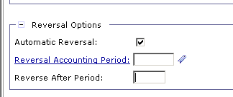

Estimated Accruals - AR
Select AR for pre-paid training orders, interagency orders, credit card purchases, direct pay and travel
  Will auto reverse when reversal information is specified in Reversal Option field.
  If Reversal Option is not selected AR will not self reverse.
Notes:
PR is universal across all GSA offices
Document number is composed of the Date and the last four numbers are a sequence

Slide 5
Creating Estimated Accrual - AR
For Credit Card, Pre-paid Training and Inter-Agency:
  FY12 CL Obligation (copy forward)
  AR Expense
  FY13 AR Auto-Reversal Expense
  CP Payment
For Travel and Direct Pay:
FY12 AR Expense
FY13 AR Minus
Voucher Payment
Notes:
Does not need a vendor (contracting officer researches to find best price)
Title is optional but highly recommended. If you search all of your PR’s whatever you write in Title will be displayed.
Requested by is who wants it, if you’re ordering for the whole office you want to know who it is going to.

Slide 6
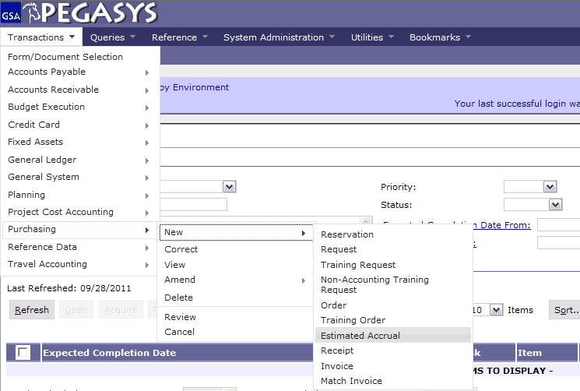
Creating Estimated Accrual - AR
Select :
- Transaction
- Purchasing
- New
- Estimated Accrual
Notes:
Description is displayed on the Transaction Summary Report

Slide 7
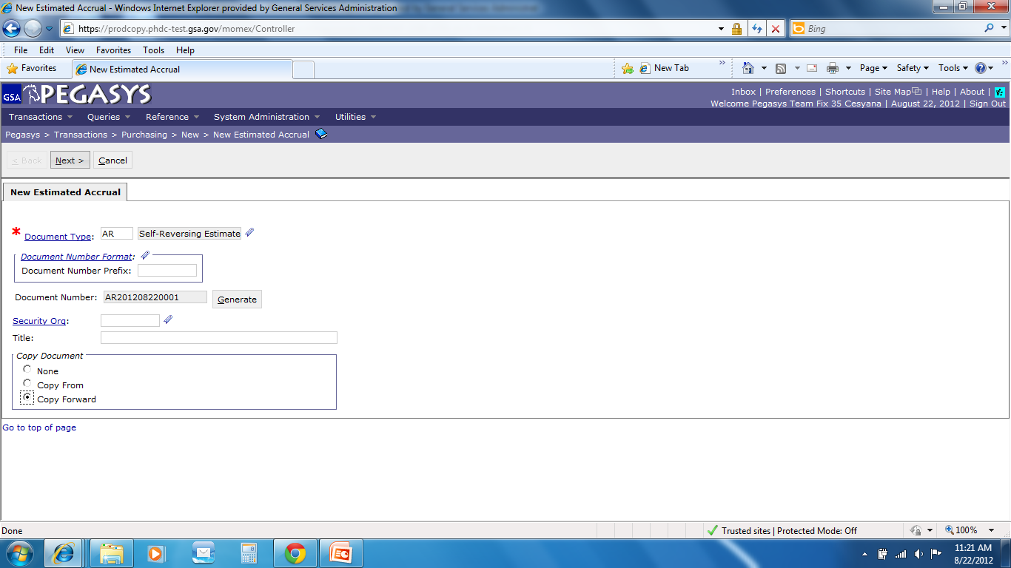
Creating – AR - Credit Card, Pre-paid Training, Inter-Agency
- Enter Document Type
- Press Tab
Click Generate
Click Copy Forward
- Click Next
Copy Forward
Copies information from the
previous document (PO) in the
chain
Notes:
Pegasys sends an email to solicit for a receipt, so put the receiver of the goods in the *Email field

Slide 8
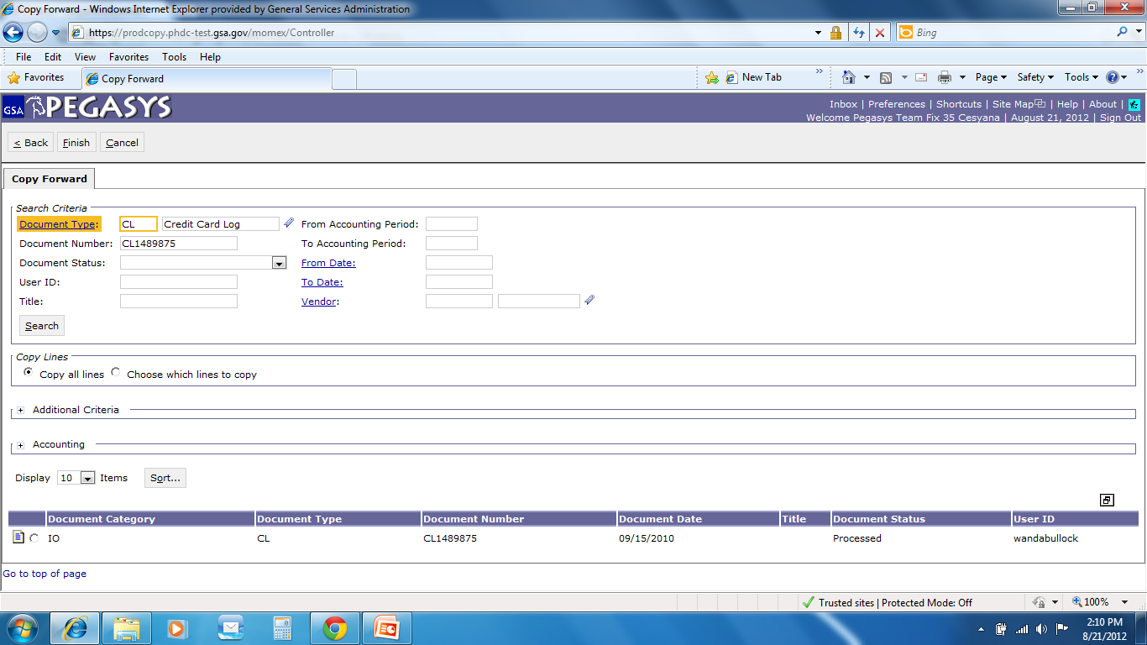
Copy Forward
Enter :
- Document Type
Document Number
Click :
Search
Highlight :
Document
Click :
- Finish
Notes:
This is OPTIONAL but you can add the contracting vendor by Suggested Vendor

Slide 9
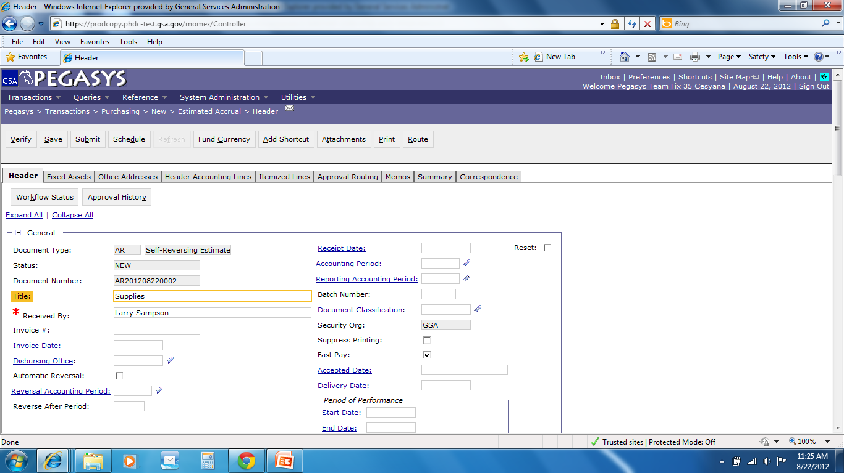
Header Page
AR201108220001
  Please adjust dollar amount, if necessary
Notes:
Code is the TIN # (tax identification number)
Use wild card because Pegasys looks for an exact match Example: Inc does not equal Inc.
If the vendor isn’t in Pegasys then you can email the finance centers in FW and KC to get the vendor put in. Takes less then 24hrs

Slide 10
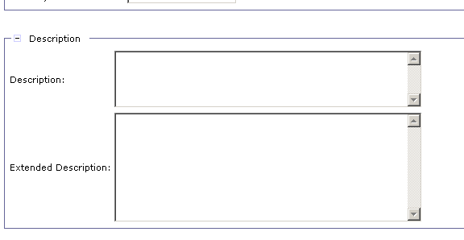
Description
Enter :
- Description
  Please add any additional information to clarify the accrual

Slide 11
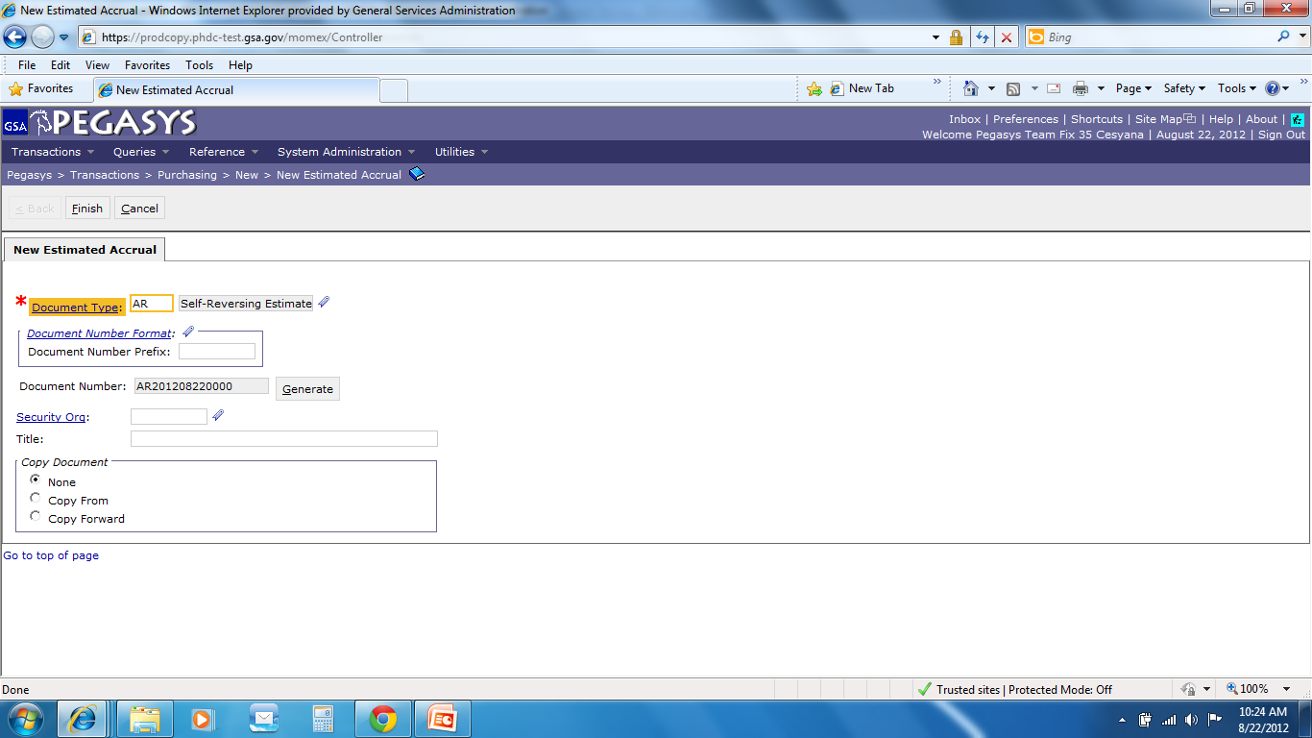
Creating – AR – Travel and Direct Pay
- Enter Document Type
- Press Tab
Click Generate
- Click Finish
Notes:
Pegasys sends an email to solicit for a receipt, so put the receiver of the goods in the *Email field

Slide 12
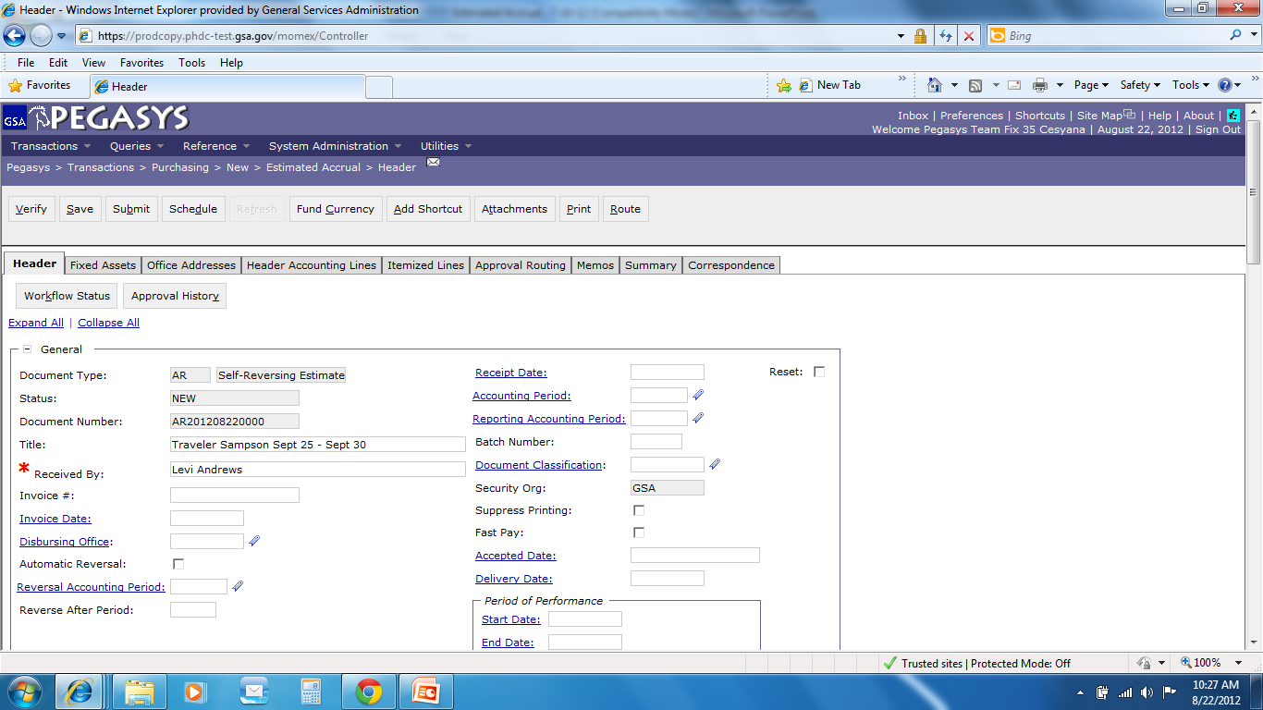
Header Page
Save Often
Enter :
Title
Received by
AR
AR201109280000
Notes:
Code is the TIN # (tax identification number)
Use wild card because Pegasys looks for an exact match Example: Inc does not equal Inc.
If the vendor isn’t in Pegasys then you can email the finance centers in FW and KC to get the vendor put in. Takes less then 24hrs

Slide 13
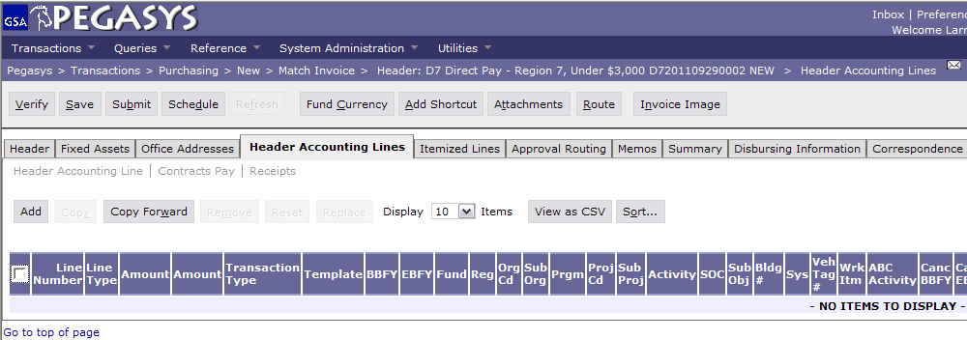
AR - Header Accounting Lines
  Tip – Preferences > Document Defaults – set a default vendor, accounting template, and currency based on document type. http://pegasys.gsa.gov/ref/howto.htm

Slide 14
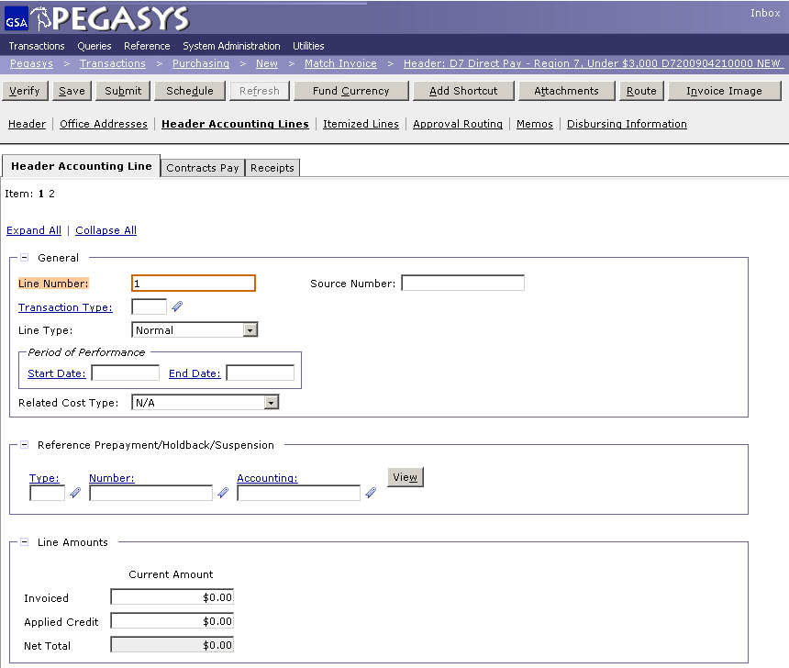
AR - Header Accounting Lines
- Add the dollar amount

Slide 15
AR - Header Accounting Lines
- Accounting Template
2012
G
00
BD
262X
CST1
S00B0410
GM&A
FY
Service
Region
Corr. Symbol
Fund
Program
Org. Code
2012
P
00
192
P0010001
PG61
PBS
FY
Service
Region
Fund
Org. Code
Program
2012
A
00
285X
AF00
A0010100
AF372
_AdTravel
FAS
FY
Service
Region
Fund
Program
Org. Code
Activity

Slide 16
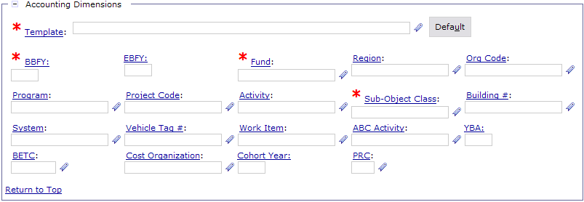

AR - Accounting Template
  For information on how to use favorites , go to http://pegasys.gsa.gov/ref/howto.htm

Slide 17
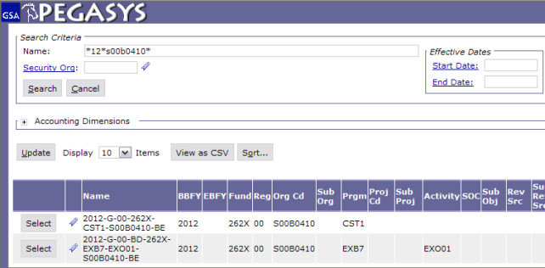
AR - Header Accounting Lines
Enter:
Criteria separated by the wildcard (*)
Click :
Search
Click :
- Select

Slide 18
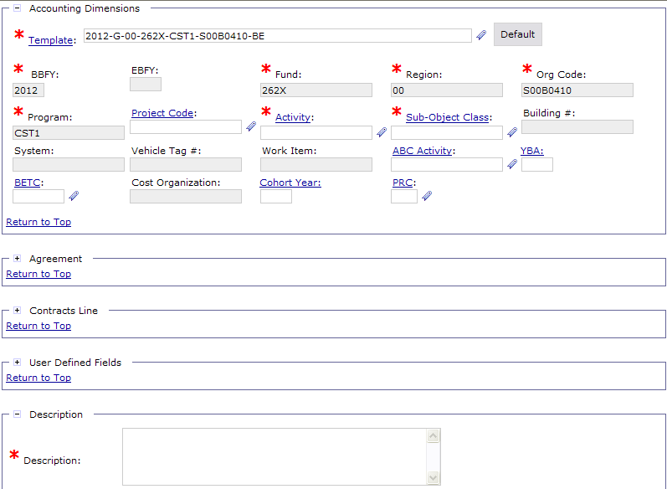
AR - Header Accounting Lines
Enter in a SOC and Activity.
Note: Your accounting classification may require other data elements to be entered, such as BLDG Number, RWA, Work Item, Vehicle Tag #, Project Code, etc.

Slide 19
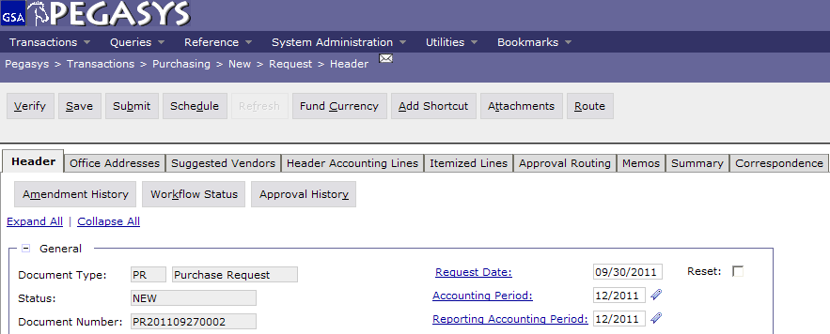
Save, Verify, Submit
  To finish the Form:
  - Save the form
  - Verify and correct any errors
  - Submit the document for approvals and processing

Slide 20
Types of Estimated Accruals
Select AN for intra-agency (IX doc type) orders.
  Does not reverse
  The NEAR interface will liquidate the accrual and the order for the amount of the payment.

Slide 21
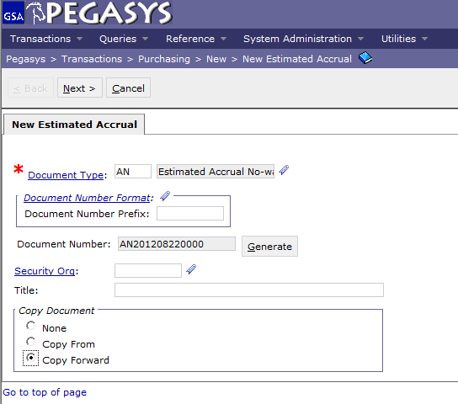
Creating Estimated Accrual - AN
- Enter Document Type
- Press Tab
Click Generate
Click Copy Forward
- Click Next
Copy Forward
Copies information from the
previous document (PO) in the
chain

Slide 22
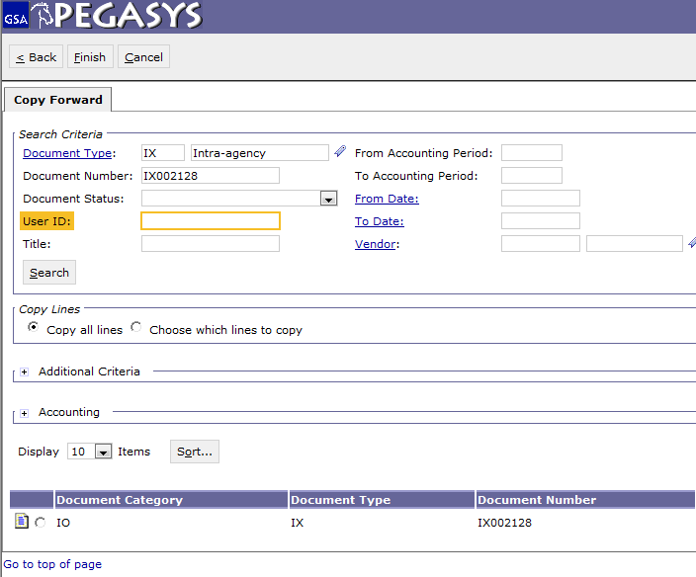
AN - Copy Forward
Enter :
- Document Type
Document Number
Click :
Search
Highlight :
Document
Click :
- Finish
Notes:
Agreement Number is the RWA number (PBS ONLY)
Drop alpha and add the number
If you have more than one accounting lines use the Description field to distinguish between them.

Slide 23
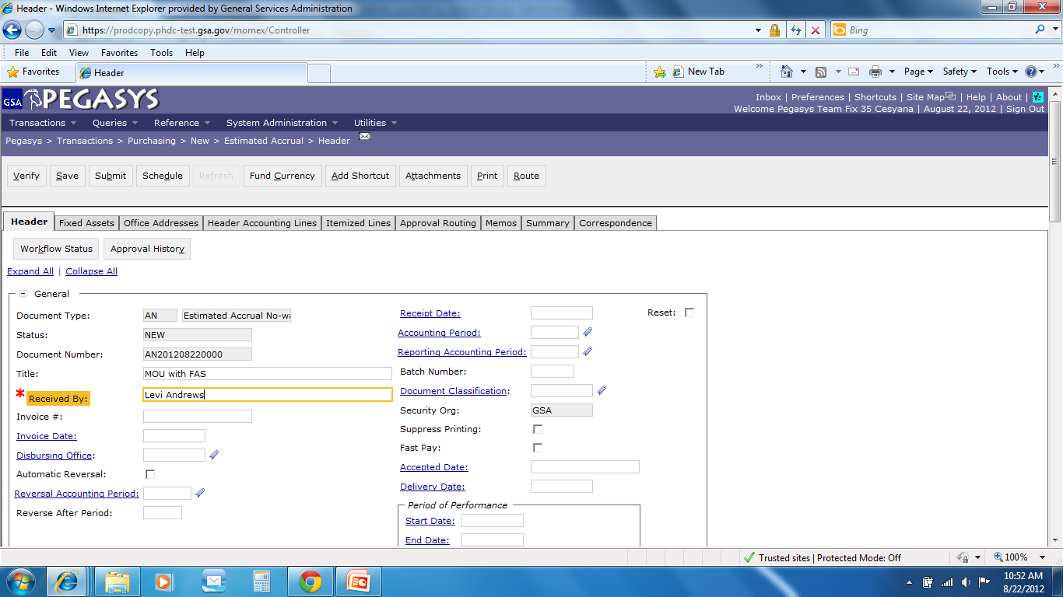
AN – Header Page
  Please adjust dollar amount, if necessary
Notes:
DEMO:
Using the new Form from the previous example, on the Header Accounting Lines tab
Click the Add button to add a line
Click the Favorites icon for the Template field
Click the Search Link
Enter CC-192X-PG61-P032C300* in the Code Field
Click the Search button
Click Favorites icon to add to Favorites
Click the Cancel button
Back on the Form, display the newly created Favorite by clicking the Favorite icon for the Template field

Slide 24
Description
Enter :
- Description
  Please add any additional information to clarify the accrual

Slide 25
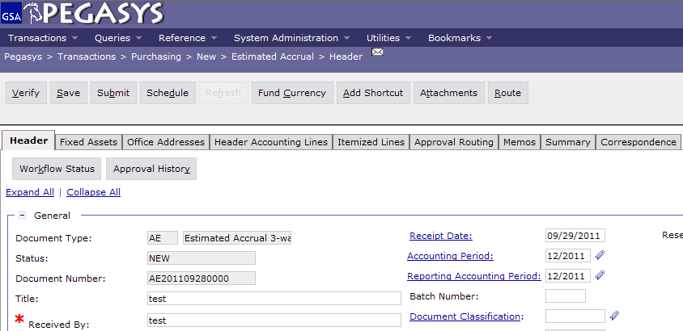
AN - Save, Verify, Submit
AN
AN201109280000
  To finish the Form:
  - Save the form
  - Verify and correct any errors
  - Submit the document for approvals and processing

Slide 26
Types of Estimated Accruals
Select AE for purchase orders.
  For a non-itemized 3-way
  Does not reverse
  Actual receipt document type RK or RW must be generated in order to liquidate
Notes:
Receipt based on goods that are physically here, or through email
Can do Receipt before Pegasys prompts you. If you get the goods and they are good then do the receipt!

Slide 27
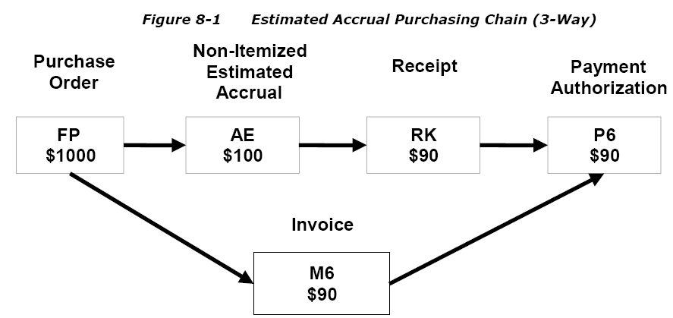
Estimated Accruals in Purchasing Chain (1)
Estimated accrual will be referenced in a receipt.
Payment is not generated until actual receipt is created and matched with the invoice and order.
Notes:
If 90% of the time when you do a credit card it is same funding then set up the accounting string as a default.

Slide 28
Estimated Accruals in Purchasing Chain (2)
Figure 8-1 Estimated Accrual Purchasing Chain (3-way)
Purchase
Order
Non-Itemized Estimated Accrual
Receipt
Payment Authorization
AE
$100
FP
$1000
RK
$150
P6
$150
$50
Invoice
M6
$150
Estimated accrual will be referenced in a receipt.
Payment is not generated until actual receipt is created and matched with the invoice and order.
Notes:
If 90% of the time when you do a credit card it is same funding then set up the accounting string as a default.

Slide 29
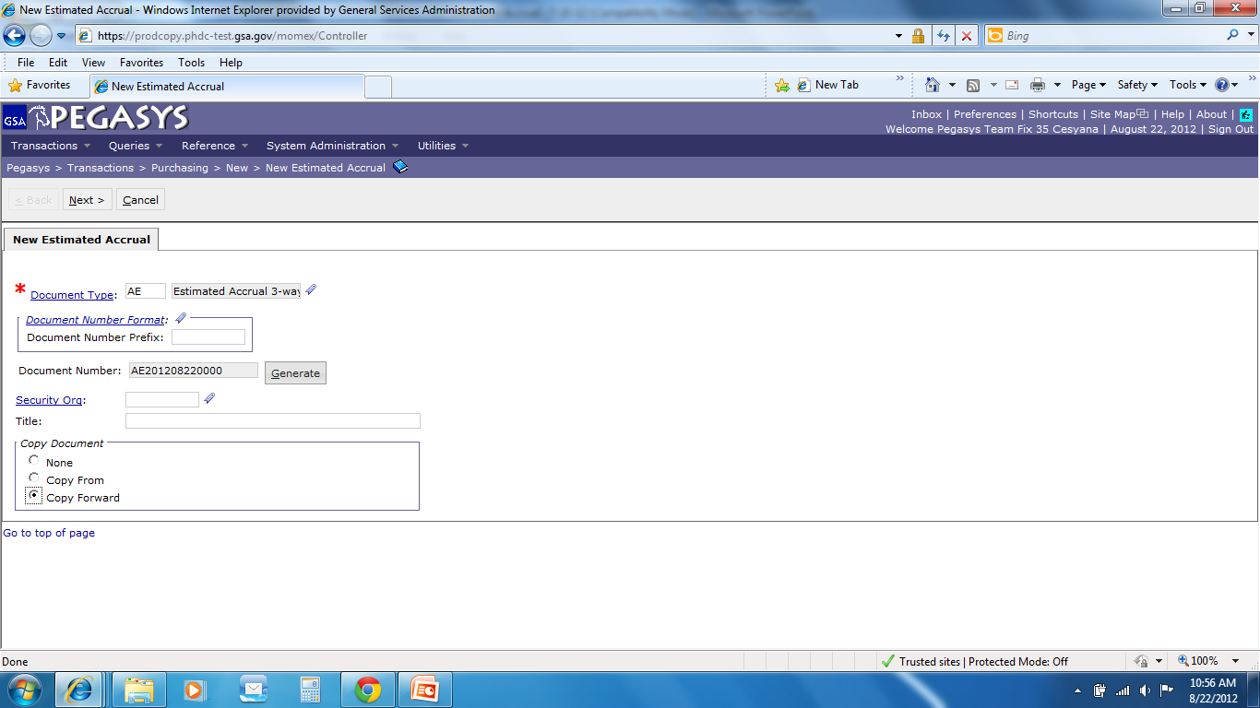
Creating Estimated Accrual - AE
- Enter Document Type
- Press Tab
Click Generate
Click Copy Forward
- Click Next
Copy Forward
Copies information from the
previous document (PO) in the
chain

Slide 30
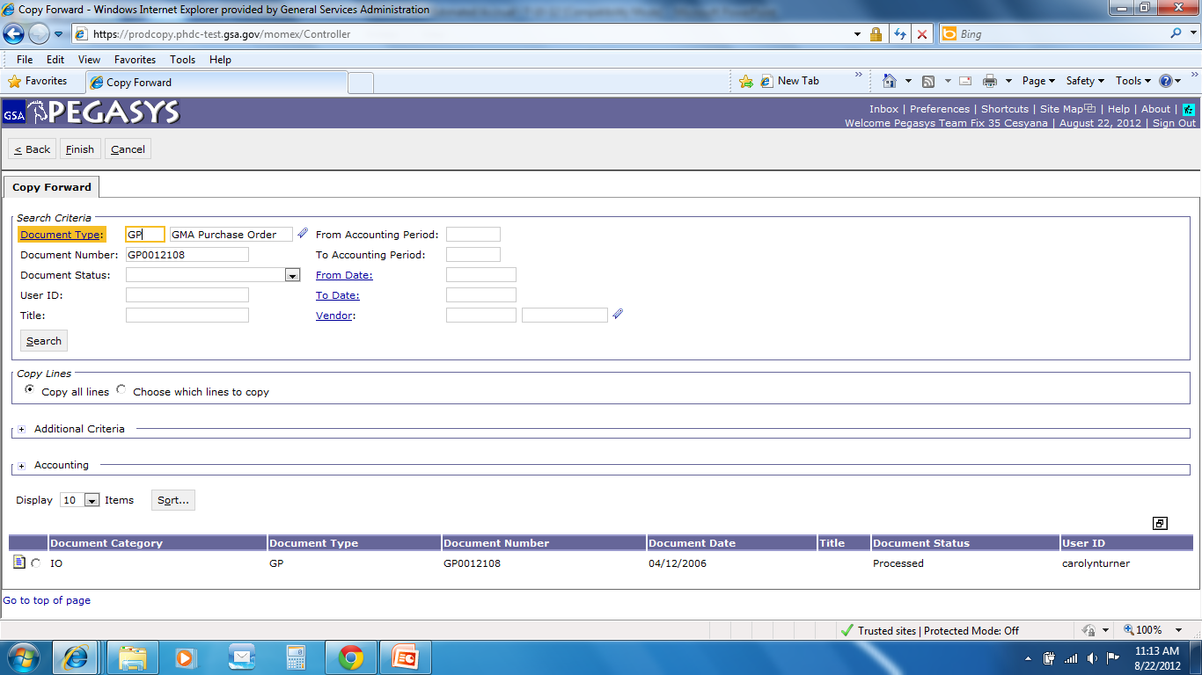
AE - Copy Forward
Enter :
- Document Type
Document Number
Click :
Search
Highlight :
Document
Click :
- Finish

Slide 31
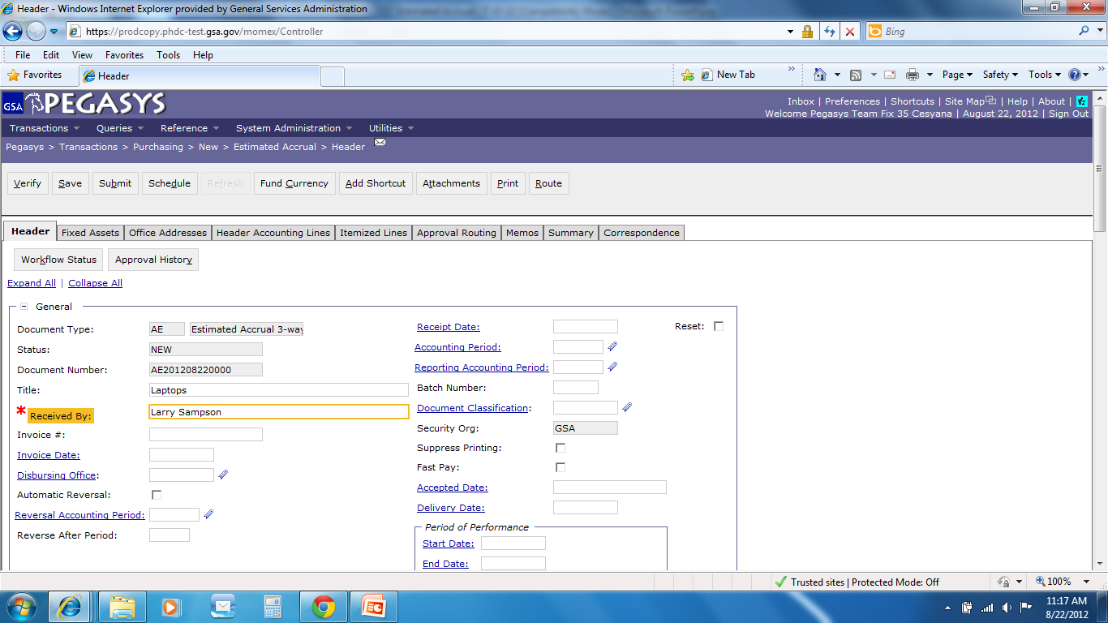
AE – Header Page
  Please adjust dollar amount, if necessary

Slide 32
Description
Enter :
- Description
  Please add any additional information to clarify the accrual

Slide 33
AE - Save, Verify, Submit
  To finish the Form:
  - Save the form
  - Verify and correct any errors
  - Submit the document for approvals and processing

Slide 34
Additional Assistance
Pegasys Web Site - http://pegasys.gsa.gov
  User Guides
  Quick Reference Cards
  Pegasys Training Classes
OCFO Consolidated Service Desk
  1-866-450-6588
  ocfoservicedesk@gsa.gov
ocfocustomerservice.gsa.gov
Notes:
If 90% of the time when you do a credit card it is same funding then set up the accounting string as a default.

Slide 35

Goals of Information Security
Confidentiality
  Data must be protected against unauthorized disclosure
Integrity
  Systems must not permit processes or data to be changed without authorization
Availability
  Systems must be functional and operational
Confidentiality
Availability
Integrity
Notes:
Please take a few moments and review the remaining slides on Information Security

Slide 36
Why is Information Security Important?
Must be in compliance with regulatory requirements such as OMB Circular A-130, Computer Security Act, FISMA and GSA IT security policies
Protects GSA information resources from potential abuse and misuse
Follows sound business practices

Slide 37
User Responsibility
Responsible for adherence to GSA information security policy
Protect Pegasys login ID and password
  Do not allow others to use your login ID / password
  Do not write it down
Log out whenever you are not using Pegasys
Protect sensitive information
  Shred reports containing sensitive information
Report security incidents
  Refer to OCFO Incident Handling Procedures for further guidance
  Report security incidents to your supervisor

Slide 38

Keys to Incident Prevention
Awareness - be aware of the value of the assets you are using to do your job and the nature of associated threats vulnerabilities and suspicious activities
Compliance - comply with established safeguards, policies, and processes
Common Sense - if something appears to be off, it generally is

Slide 39

Remember ...
Security is a PEOPLE issue,
not only a TECHNICAL one!

